Slide 1
COMP6115 Object Oriented Analysis and Design Session #11

Slide 2
Physical Architecture Layer Design

Slide 3
Learning Outcomes
LO1: Identify the basic concept of advance topic in
Object Oriented Analysis and Design
LO2 : Use the knowledge to develop documentation
for object oriented software analysis and
design using Unified Modelling Language
LO3 : Analyze any problem in any software
application and find out the alternative
solutions using object oriented analysis and
design approach

Slide 4
Chapter 11: Physical Architecture Layer Design

Slide 5
Objectives
Understand the different physical architecture components.
Understand server-based, client-based, and client–server physical architectures.
Be familiar with cloud computing and Green IT.
Be able to create a network model using a deployment diagram.
Be familiar with how to create a hardware and software specification.
Understand how operational, performance, security, cultural, and political requirements affect the design of the physical architecture layer.

Slide 6
Introduction
Most modern systems span two or more networked computers
The physical architecture layer design specifies:
How the system will be distributed across the computers
What hardware and software will be used
Most systems design is constrained by existing systems and networks
Physical architecture design is demanding
Knowledge of key factors is essential
Nonfunctional requirements play a key role

Slide 7
Elements of the Physical Architecture Layer
Purpose is to decide which applications run on what hardware
Process:
Understand the software and hardware options, then
Choose from the available alternatives, based on:
Cost of acquisition
Cost of development
Ease of development
Interface capabilities
Control & security
Scalability

Slide 8
Architectural Components
Software components
Data storage
Data access logic
Application logic
Presentation logic
Hardware components
Clients (computers, handhelds, cell phones, etc.)
Servers (mainframes, minis, micros, rack mounted)
Networks to connect all computers (Dial-up, always-on, medium or high speed, leased lines)

Slide 9
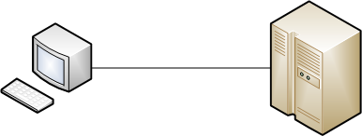
Server-Based Architectures
The server performs all four application functions
The client (usually a terminal with display and keyboard) captures keystrokes and sends them to the server for processing
Data Storage
Data Access Logic
Application Logic
Presentation Logic

Slide 10

Client-Based Architectures
Clients are personal computers on a network
Server is a file server on the same network
Simple to develop, but quickly overloaded
All data is downloaded to the client for processing
Network traffic may become excessive
Client may not have enough computing power
Data Access Logic
Application Logic
Presentation Logic
Data Storage

Slide 11

Client-Server Architectures
Balance processing between client and server
Predominant architecture in modern systems
Amount of client processing varies
Thin clients do only presentation logic
Thick clients do presentation and application
Highly scalable at incremental cost
More complex since applications must be written for both client and server
Data Storage
Data Access Logic
Application Logic
(Thin client)
Application Logic
(Thick client)
Presentation Logic

Slide 12
Client-Server Tiers
Client-server architecture tiers are defined based on how the logic is partitioned:
2-tier: one server responsible for data storage and access; client responsible for application & presentation logic
3-tier: data storage and access logic on one server, application logic on another; client responsible for presentation logic
n-tier: application logic split among two servers, data logic on another
Common in e-commerce applications
Better load balancing
More scalable than 2 or 3 tier systems
Places higher demands on the network

Slide 13
Selecting a Physical Architecture
Cost of infrastructure (initial acquisition and future growth)
Cost of development
Ease of development
Interface capabilities
Control and security
Scalability (changes in capacity; upgrades)

Slide 14
Architecture Characteristics
 | Server-Based | Client-Based | Client-Server
Cost of infrastructure | Very high | Medium | Low
Cost of development | Medium | Low | High
Ease of development | Low | High | Low-Medium
Interface capabilities | Low | High | High
Control and Security | High | Low | Medium
Scalability | Low | Medium | High

Slide 15
Cloud Computing
Treat IT as a commodity or utility
Server is in the “cloud”
Client is on the desktop
The “cloud”
A data center, internal or external; or
A service provided by a vendor
An umbrella technology that includes:
Virtualization
Service-oriented architectures
Grid computing

Slide 16
UBIQUITOUS COMPUTING AND THE INTERNET OF THINGS
General computing devices
Smartphones and tablets may have many different apps that provide all types of computing and communication support
Specialized computing devices
Enchanted objects and specialized devices

Slide 17
Green IT
Anything that reduces the environmental impact of IT
Topics:
E-waste (disposal of toxic materials in old computers)
Energy consumption of data centers and desktops
The paperless office
Cloud computing may help to reduce energy consumption and improve the viability of the paperless office

Slide 18
Infrastructure Design
Although possible, few designs are from scratch
Most designs utilize systems already in place
Change or improve the existing infrastructure
Coordination is difficult, but knowledge of elements is essential
Deployment diagram
Network model

Slide 19
Deployment Diagram
Represent relationships between hardware components of an information system
Elements of a deployment diagram
Nodes: any piece of hardware (e.g. client computers, servers, networks or network devices)
Artifacts: a piece of the information system which will be installed on a node
Communication paths: a communication link between the nodes

Slide 20
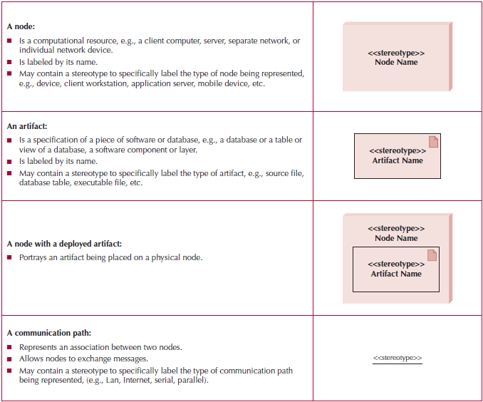
Deployment Diagram Syntax

Slide 21
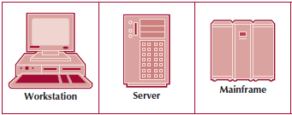
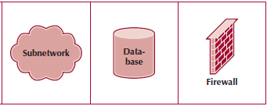
Extended Node Syntax

Slide 22
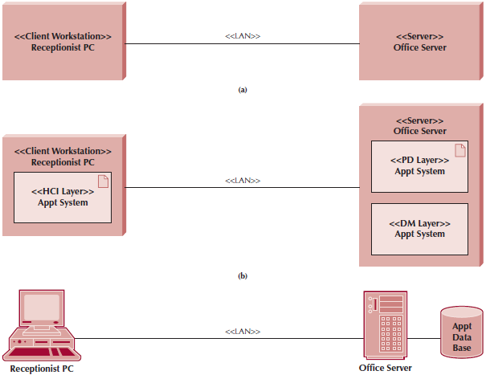
Sample Deployment Diagrams

Slide 23
Network Model
A network diagram that depicts the major components and their geographic locations in the organization
Purposes of the network model:
To convey the complexity of the system
To show how the system’s software components will fit together
Can serve as an aid for specifying hardware and software

Slide 24
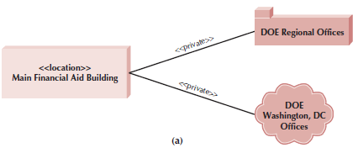
Sample Network Model

Slide 25
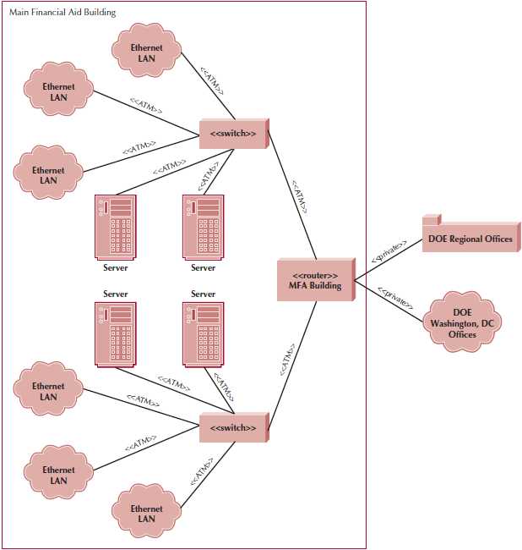
Diagram With Added Detail

Slide 26
Hardware & Software Specifications
Hardware & software needed for the new application is recorded in a specifications document
Software requirements:
Operating system
Special purpose software (e.g., DBMS)
Include training needed, maintenance, warranties and licensing agreements
Hardware requirements
Use low level network diagram as a starting point
Include type & quantity of servers, peripherals, storage & backup devices
Describe minimum requirements
Use an alternative matrix to evaluate vendor proposals

Slide 27
Nonfunctional Requirements
Operational
Technical environment
System integration
Portability
Maintainability
Performance
Speed
Capacity
Availability & reliability
Security
System value
Access control
Encryption & authentication
Virus control
Cultural & political influence
Centralized vs. local control
Language differences (keyboard requirements)
Legal implications
Laws & government regulations
Global presence requires scrutiny of local laws

Slide 28
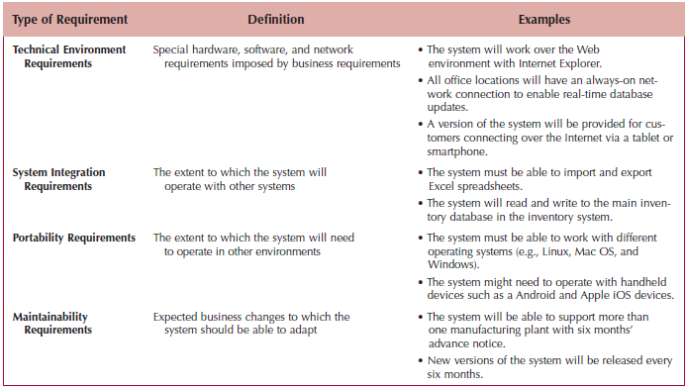
Operational Requirements

Slide 29
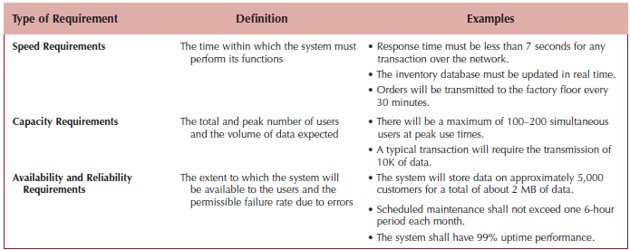
Performance Requirements

Slide 30
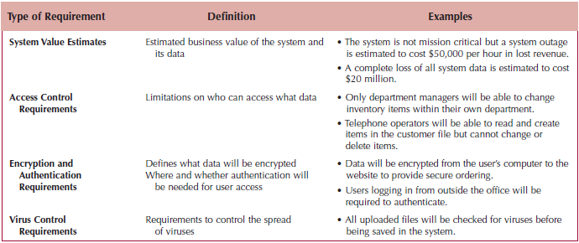
Security Requirements

Slide 31
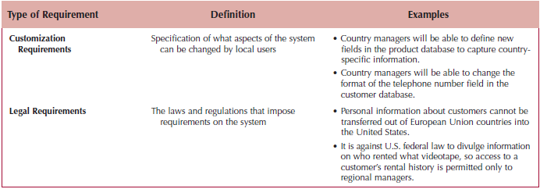
Cultural & Political Requirements

Slide 32
Summary
Elements of the Physical Architecture Layer
Cloud Computing
Green IT
Ubiquitous computing and the internet of things
Infrastructure Design
Hardware & Software Specifications
Nonfunctional Requirements

Slide 33
References
Denis, Wixom,Tegarden. (2015). Systems Analysis and Design: An Object-Oriented Approach with UML. 5th edition. ISBN: 978-1-118-80467-4, John Wiley & Sons, Inc, Denver (USA)

